Slide 1
Big Data Analytics IDS 561
Yuheng Hu Assistant Professor Dept. of Information and Decision Sciences

Slide 2

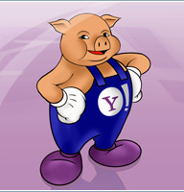
Review of Hive/Pig
Hive: data warehousing application in Hadoop
Query language is HQL, variant of SQL
Tables stored on HDFS as flat files
Developed by Facebook, now open source
Pig: large-scale data processing system
Scripts are written in Pig Latin, a dataflow language
Developed by Yahoo!, now open source
Roughly 1/3 of all Yahoo! internal jobs
Common idea:
Provide higher-level language to facilitate large-data processing
Higher-level language “compiles down” to Hadoop jobs

Slide 3
Pig : Building High-Level Dataflows over Map-Reduce

Slide 4
Example Data Analysis Task
Find users who tend to visit “good” pages.
Visits
Pages
user | url | time
Amy | www.cnn.com | 8:00
Amy | www.crap.com | 8:05
Amy | www.myblog.com | 10:00
Amy | www.flickr.com | 10:05
Fred | cnn.com/index.htm | 12:00
url | category | pagerank
www.cnn.com | news | 0.9
www.flickr.com | picture | 0.9
www.myblog.com | blog | 0.7
www.crap.com |  | 0.2
. . .
. . .
Pig Slides adapted from Olston et al.

Slide 5
Data Flow
Load Visits
Group by url
Foreach url
generate count
Load Url Info
Join on url
Group by category
Foreach category
generate top10 urls

Slide 6
In Pig Latin
visits = load ‘/data/visits’ as (user, url, time);
gVisits = group visits by url;
visitCounts = foreach gVisits generate url, count(visits);
urlInfo = load ‘/data/urlInfo’ as (url, category, pRank);
visitCounts = join visitCounts by url, urlInfo by url;
gCategories = group visitCounts by category;
topUrls = foreach gCategories generate top(visitCounts,10);
store topUrls into ‘/data/topUrls’;

Slide 7
Quick Start and Interoperability
visits = load ‘/data/visits’ as (user, url, time);
gVisits = group visits by url;
visitCounts = foreach gVisits generate url, count(urlVisits);
urlInfo = load ‘/data/urlInfo’ as (url, category, pRank);
visitCounts = join visitCounts by url, urlInfo by url;
gCategories = group visitCounts by category;
topUrls = foreach gCategories generate top(visitCounts,10);
store topUrls into ‘/data/topUrls’;
Operates directly over files

Slide 8
Quick Start and Interoperability
visits = load ‘/data/visits’ as (user, url, time);
gVisits = group visits by url;
visitCounts = foreach gVisits generate url, count(urlVisits);
urlInfo = load ‘/data/urlInfo’ as (url, category, pRank);
visitCounts = join visitCounts by url, urlInfo by url;
gCategories = group visitCounts by category;
topUrls = foreach gCategories generate top(visitCounts,10);
store topUrls into ‘/data/topUrls’;
Schemas optional;
Can be assigned dynamically

Slide 9
User-Code as a First-Class Citizen
visits = load ‘/data/visits’ as (user, url, time);
gVisits = group visits by url;
visitCounts = foreach gVisits generate url, count(urlVisits);
urlInfo = load ‘/data/urlInfo’ as (url, category, pRank);
visitCounts = join visitCounts by url, urlInfo by url;
gCategories = group visitCounts by category;
topUrls = foreach gCategories generate top(visitCounts,10);
store topUrls into ‘/data/topUrls’;
User-defined functions (UDFs) can be used in every construct
Load, Store
Group, Filter, Foreach

Slide 10
Nested Data Model
Pig Latin has a fully-nestable data model with:
Atomic values, tuples, bags (lists), and maps
More natural to programmers than flat tuples
Avoids expensive joins
finance
yahoo ,
email
news

Slide 11
Nested Data Model
Decouples grouping as an independent operation
User | Url | Time
Amy | cnn.com | 8:00
Amy | bbc.com | 10:00
Amy | bbc.com | 10:05
Fred | cnn.com | 12:00
group | Visits
cnn.com | Amy | cnn.com | 8:00
 | Fred | cnn.com | 12:00
bbc.com | Amy | bbc.com | 10:00
 | Amy | bbc.com | 10:05
group by url
Common case: aggregation on these nested sets
Power users: sophisticated UDFs, e.g., sequence analysis
Efficient Implementation (see paper)
I frankly like pig much better than SQL in some respects (group + optional ﬂatten works better for me, I love nested data structures).”
Ted Dunning
Chief Scientist, Veoh

Slide 12
CoGroup
results
revenue
query | url | rank
Lakers | nba.com | 1
Lakers | espn.com | 2
Kings | nhl.com | 1
Kings | nba.com | 2
query | adSlot | amount
Lakers | top | 50
Lakers | side | 20
Kings | top | 30
Kings | side | 10
group | results |  |  | revenue
Lakers | Lakers | nba.com | 1 | Lakers | top | 50
 | Lakers | espn.com | 2 | Lakers | side | 20
Kings | Kings | nhl.com | 1 | Kings | top | 30
 | Kings | nba.com | 2 | Kings | side | 10
Cross-product of the 2 bags would give natural join

Slide 13
Compilation into Map-Reduce
Map₁
Every group or join operation forms a map-reduce boundary
Load Visits
Group by url
Reduce₁
Map₂
Foreach url
generate count
Load Url Info
Join on url
Reduce₂
Map₃
Other operations pipelined into map and reduce phases
Group by category
Reduce₃
Foreach category
generate top10(urls)

Slide 14
MapReduce Code
Pig Slides adapted from Olston et al.

Slide 15
Pig Latin Script
Visits = load ‘/data/visits’ as (user, url, time);
Visits = foreach Visits generate user, Canonicalize(url), time;
Pages = load ‘/data/pages’ as (url, pagerank);
VP = join Visits by url, Pages by url;
UserVisits = group VP by user;
UserPageranks = foreach UserVisits generate user, AVG(VP.pagerank) as avgpr;
GoodUsers = filter UserPageranks by avgpr > ‘0.5’;
store GoodUsers into '/data/good_users';
Pig Slides adapted from Olston et al.

Slide 16
Java vs. Pig Latin
1/20 the lines of code
1/16 the development time
Performance on par with raw Hadoop!
Pig Slides adapted from Olston et al.

Slide 17
Example Data Analysis Task
Find users who tend to visit “good” pages.
Visits
Pages
user | url | time
Amy | www.cnn.com | 8:00
Amy | www.crap.com | 8:05
Amy | www.myblog.com | 10:00
Amy | www.flickr.com | 10:05
Fred | cnn.com/index.htm | 12:00
url | pagerank
www.cnn.com | 0.9
www.flickr.com | 0.9
www.myblog.com | 0.7
www.crap.com | 0.2
. . .
. . .
Pig Slides adapted from Olston et al.

Slide 18

Examples to Illustrate Program
LOAD
(user, url)
LOAD
(url, pagerank)
(www.cnn.com, 0.9)
(www.frogs.com, 0.3)
(www.snails.com, 0.4)
(Amy, cnn.com)
(Amy, http://www.frogs.com)
(Fred, www.snails.com/index.html)
JOIN
on url
(Amy, www.cnn.com, 0.9)
(Amy, www.frogs.com, 0.3)
(Fred, www.snails.com, 0.4)
FOREACH
user, canonicalize(url)
GROUP
on user
(Amy, www.cnn.com, 0.9)
(Amy, www.frogs.com, 0.3)
(Fred, www.snails.com, 0.4)
( Amy,
)
FOREACH
user, AVG(pagerank)
( Fred,
)
(Amy, www.cnn.com)
(Amy, www.frogs.com)
(Fred, www.snails.com)
(Amy, 0.6)
(Fred, 0.4)
FILTER
avgPR> 0.5
(Amy, 0.6)
Notes:
this is what someone would write by hand, or when teaching a class

Slide 19
Pig takes care of…
Schema and type checking
Translating into efficient physical dataflow
(i.e., sequence of one or more MapReduce jobs)
Exploiting data reduction opportunities
(e.g., early partial aggregation via a combiner)
Executing the system-level dataflow
(i.e., running the MapReduce jobs)
Tracking progress, errors, etc.

Slide 20
Hive vs. Pig
Very similar, except Hive is easier to use but Pig gives more control
Pig Latin is procedural, where SQL is declarative.
Pig Latin allows the developer to select specific operator implementations directly rather than relying on the optimizer.
Users = load 'users' as (name, age, ipaddr);
Clicks = load 'clicks' as (user, url, value);
ValuableClicks = filter Clicks by value > 0;
UserClicks = join Users by name, ValuableClicks by user; Geoinfo = load 'geoinfo' as (ipaddr, dma);
UserGeo = join UserClicks by ipaddr, Geoinfo by ipaddr; ByDMA = group UserGeo by dma;
ValuableClicksPerDMA = foreach ByDMA generate group, COUNT(UserGeo);
store ValuableClicksPerDMA into 'ValuableClicksPerDMA';
insert into ValuableClicksPerDMA select dma, count(*) from geoinfo join (select name, ipaddr from users join clicks on (users.name = clicks.user) where value > 0; ) using ipaddr group by dma;

Slide 21
How to process/manage Big data?
What we have so far:
Hadoop/HDFS
For large scale batching processing
Hive/Pig
SQL-like grammar
Pros:
Very large scale processing, running on cheap hardware
Cons:
Can be slow in some cases
File-based storage sometimes is too simple while designing schemas sometimes is too hard

Slide 22
Hadoop processing scenarios
One giant input:
e.g., a big file
Hadoop processing
Good for large-scale batch processing! E.g., a job take 24hr on a 100T data

Slide 23
Other scenarios
Data organized in terms of many “records”
Records is mutable, e.g., can be modified, updated
Data unlikely to fit on single machine, must be distributed
We want to keep track of mutable data in a scalable manner
What are these scenarios?

Slide 24
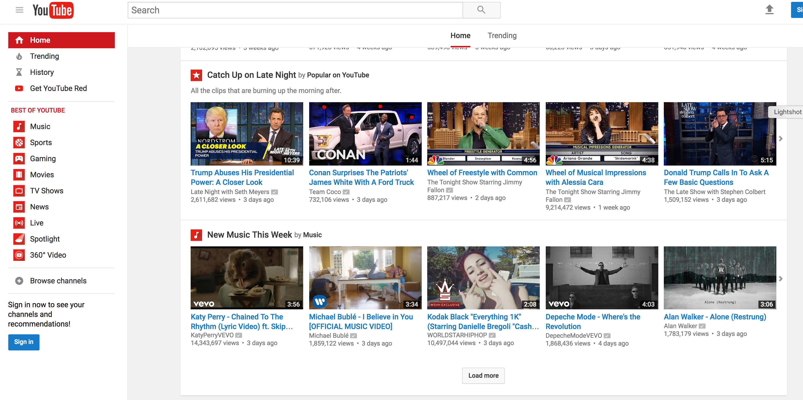


Slide 25
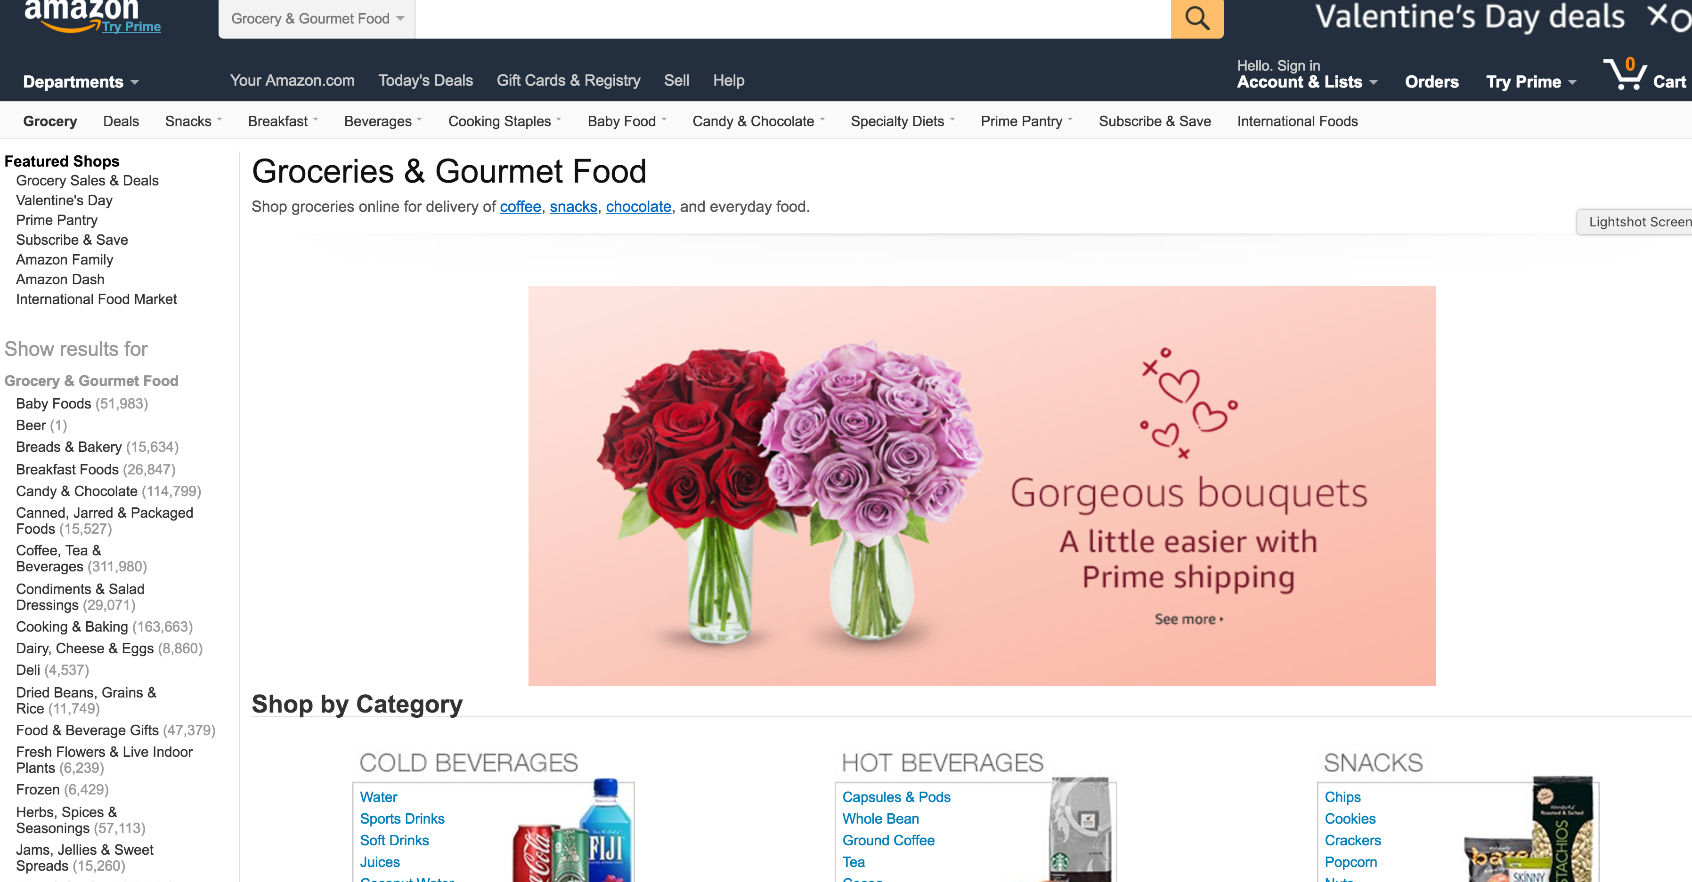
We need data storage tools other than Hadoop

Slide 26
Big Data management
Three Core Ideas
Partitioning (sharding)
For scalability
For latency
Replication
For robustness (availability)
For throughput
Caching
For latency

Slide 27
Sharding
Vertical Partitioning: Have tables related to a specific feature sit on their own server. May have to rebalance or reshard if tables outgrow server.
Key or Hash-Based partitioning: Use a key value in a hash and use the resulting value as entry into multiple servers.
Directory-Based Partitioning: Have a lookup service that has knowledge of the partitioning scheme . This allows for the adding of servers or changing the partition scheme without changing the application.
Notes:
-> Different sharding approaches:
-> Vertical Partitioning: Have tables related to a specific feature sit on their own server. May have to rebalance or reshard if tables outgrow server.
-> Range-Based Partitioning: When single table cannot sit on a server, split table onto multiple servers. Split table based on some critical value range.
-> Key or Hash-Based partitioning: Use a key value in a hash and use the resulting value as entry into multiple servers.
-> Directory-Based Partitioning: Have a lookup service that has knowledge of the partitioning scheme . This allows for the adding of servers or
changing the partition scheme without changing the application.
-> http://adam.heroku.com/past/2009/7/6/sql_databases_dont_scale

Slide 28
Replication

Slide 29
Caching - Facebook Architecture
memcached
MySQL
Read path:
Look in memcached
Look in MySQL
Populate in memcached
Write path:
Write in MySQL
Remove in memcached
Subsequent read:
Look in MySQL
Populate in memcached
✔
Source: www.facebook.com/note.php?note_id=23844338919

Slide 30
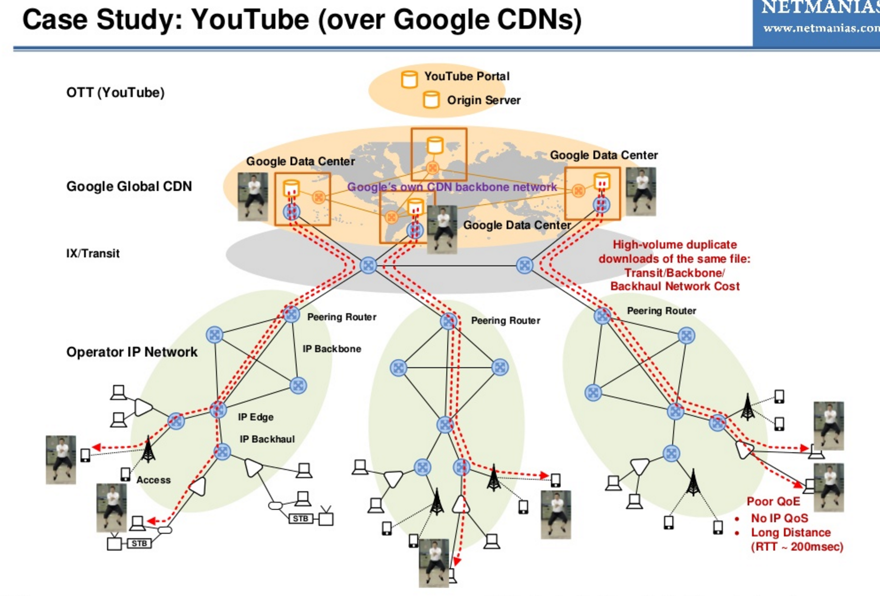
Put things together
Sharding
Replications
Cache
Cache

Slide 31
Challenges
How to partitions data?
How do we keep replications in sync?
What happens to the cache/replications/shards when the underlying data/machine changes?
Consistency matters…

Slide 32
Consistency matters…
People you don’t want seeing your pictures:
Alice removes mom from list of people who can view photos
Alice posts embarrassing pictures from Spring Break
Can mom see Alice’s photo?
Why am I still getting messages?
Bob unsubscribes from mailing list
Message sent to mailing list right after
Does Bob receive the message?

Slide 33
Consistency model
The row X is replicated on nodes M and N
The client A writes row X to node N
After a period of time t, client B reads row X from node M
The consistency model has to determine whether client B sees the write from client A or not.
Bad consistency!

Slide 34

Relational Databases
… to the rescue!
Source: images.wikia.com/batman/images/b/b1/Bat_Signal.jpg

Slide 35
What do RDBMSes provide?
Relational model with schemas
Powerful, flexible query language
Transactional semantics: ACID
Rich ecosystem, lots of tool support

Slide 36
How do RDBMSes do it?
Transactions on a single machine: (relatively) easy!
Partition tables to keep transactions on a single machine
Example: partition by user
What about transactions that require multiple machine?
Example: transactions involving multiple users
Solution: ACID

Slide 37
ACID Consistency
A DBMS is expected to support “ACID transactions,” processes that are:
Atomic : Either the whole process is done or none is.
Consistent : Database constraints are preserved.
Isolated : It appears to the user as if only one process executes at a time.
Durable : Effects of a process do not get lost if the system crashes.

Slide 38
Atomic
Okay everyone, PREPARE!
YES
Good. COMMIT!
ACK!
YES
DONE!
ACK!
Coordinator
YES
ACK!
subordinates

Slide 39
Atomic
Okay everyone, PREPARE!
YES
ABORT!
YES
Coordinator
NO
subordinates

Slide 40
Atomic
Okay everyone, PREPARE!
YES
Good. COMMIT!
ACK!
YES
ROLLBACK!
ACK!
Coordinator
YES
subordinates

Slide 41
Atomic
Okay everyone, PREPARE!
YES
Good. COMMIT!
ACK!
YES
ROLLBACK!
ACK!
Coordinator
YES
subordinates

Slide 42
Consistent
Okay everyone, Let A+B=100
A=90
A=30
B=10
ROLLBACK!
B=10!
Coordinator
subordinates

Slide 43

RDBMSes: Pain Points
Source: www.flickr.com/photos/spencerdahl/6075142688/

Slide 44
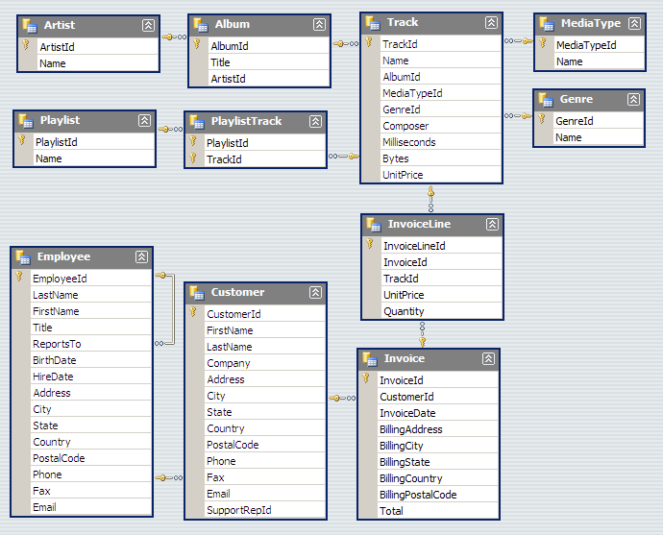
#1: Must design up front, painful to evolve

Slide 45
ACID is slow
Assumptions:
Persistent storage and write-ahead log at every node
Limitations:
It’s blocking and slow
What if the coordinator dies?
ACID is hard to achieve, moreover, it is not always required, e.g. for blogs, status updates, product listings, etc.

Slide 46
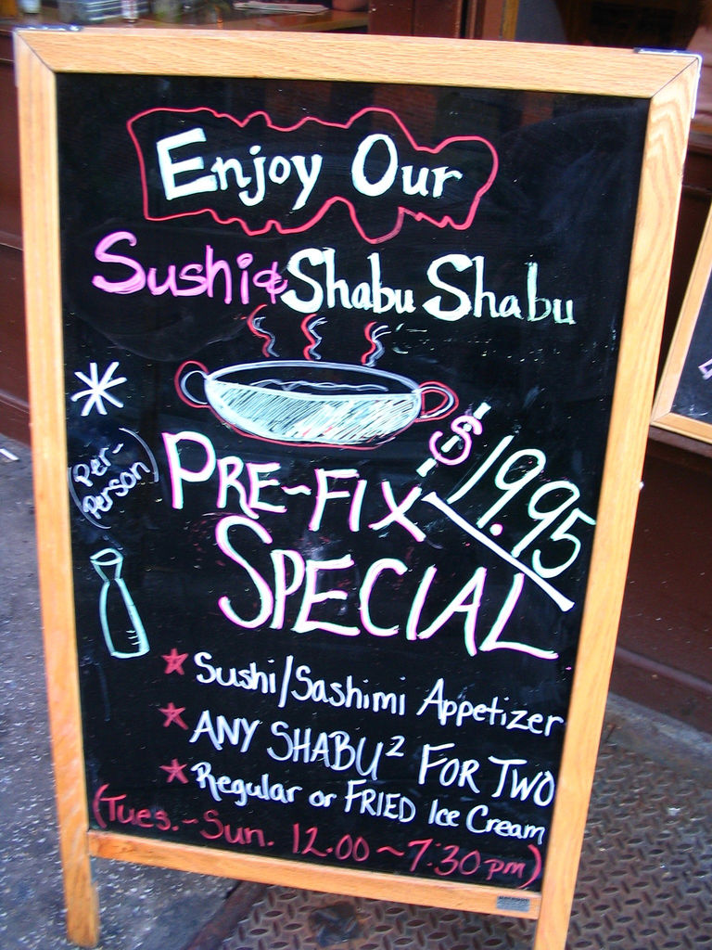
What do RDBMSes provide?
Relational model with schemas
Powerful, flexible query language
Transactional semantics: ACID
Rich ecosystem, lots of tool support
What if we want a la carte?

Slide 47
Features a la carte?
What if I’m willing to give up consistency for scalability?
What if I’m willing to give up the relational model for something more flexible?
What if I just want a cheaper solution?
Enter… NoSQL!

Slide 48
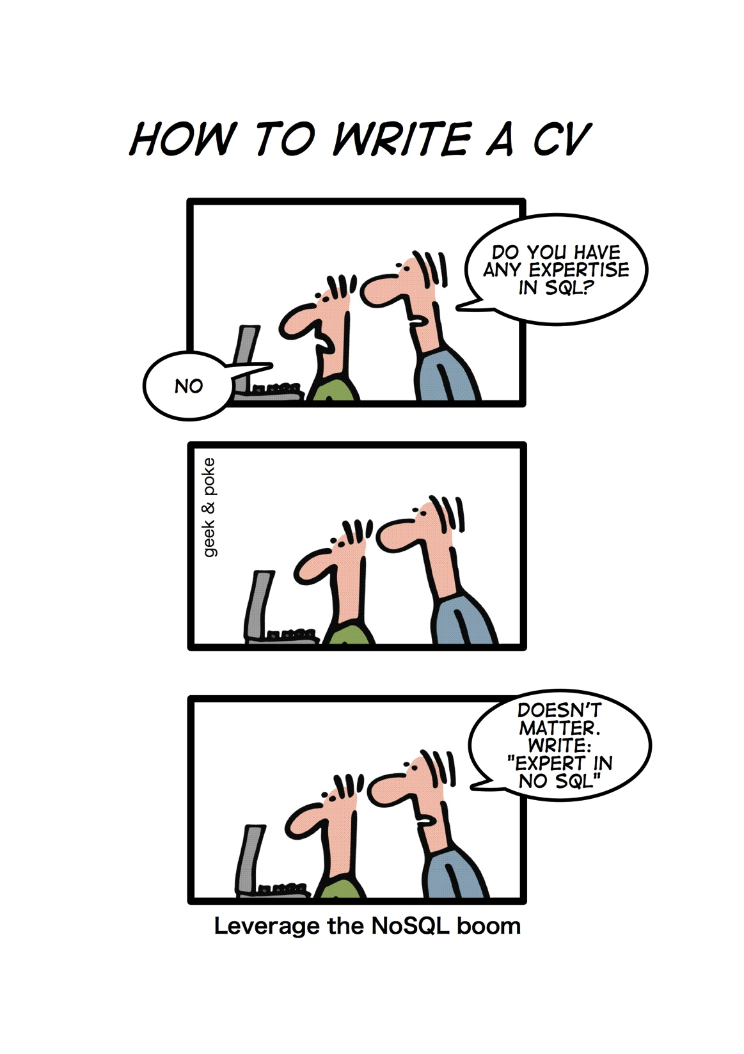
Source: geekandpoke.typepad.com/geekandpoke/2011/01/nosql.html

Slide 49
NoSQL
(Not only SQL)
Horizontally scale “simple operations”
Replicate/distribute data over many servers
Simple call interface
Weaker concurrency model than ACID
Efficient use of distributed indexes and RAM
Flexible schemas
Relational databases offer a very good general purpose solution to many different data storage needs. In other words, it is the safe choice and will work in many situations.
https://www.xplenty.com/blog/2014/05/hive-vs-hbase/ for Hive vs. NoSQL
Source: Cattell (2010). Scalable SQL and NoSQL Data Stores. SIGMOD Record.

Slide 50
NoSQL scenario: Web log analysis
Each record: UserID, URL, timestamp, additional-info
Separate records: UserID, name, age, gender, …
Task: Find average age of user accessing given URL

Slide 51
NoSQL scenario: Blog Pages
Large collection of documents
Combination of structured and unstructured data
Task: Retrieve texts and images

Slide 52
More Programming and Less Database Design - NoSQL
Alternative to traditional relational DBMS
Flexible schema
Quicker/cheaper to set up
Massive scalability
Relaxed consistency -> higher performance & availability
No declarative query language -> more programming
Relaxed consistency -> fewer guarantees

Slide 53
(Major) Types of NoSQL databases
Key-value stores
Column-oriented databases
Document stores
Graph databases
Next week

Slide 54
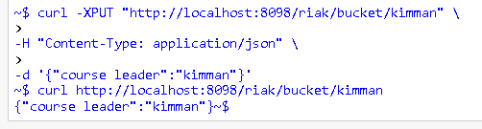
Key-Value Stores: SimpleDB
Based on Amazon’s Single Storage Service (S3)
items (represent objects) having one or more pairs (name, value), where name denotes an attribute.
An attribute can have multiple values.
items are combined into domains.
https://aws.amazon.com/simpledb/

Slide 55
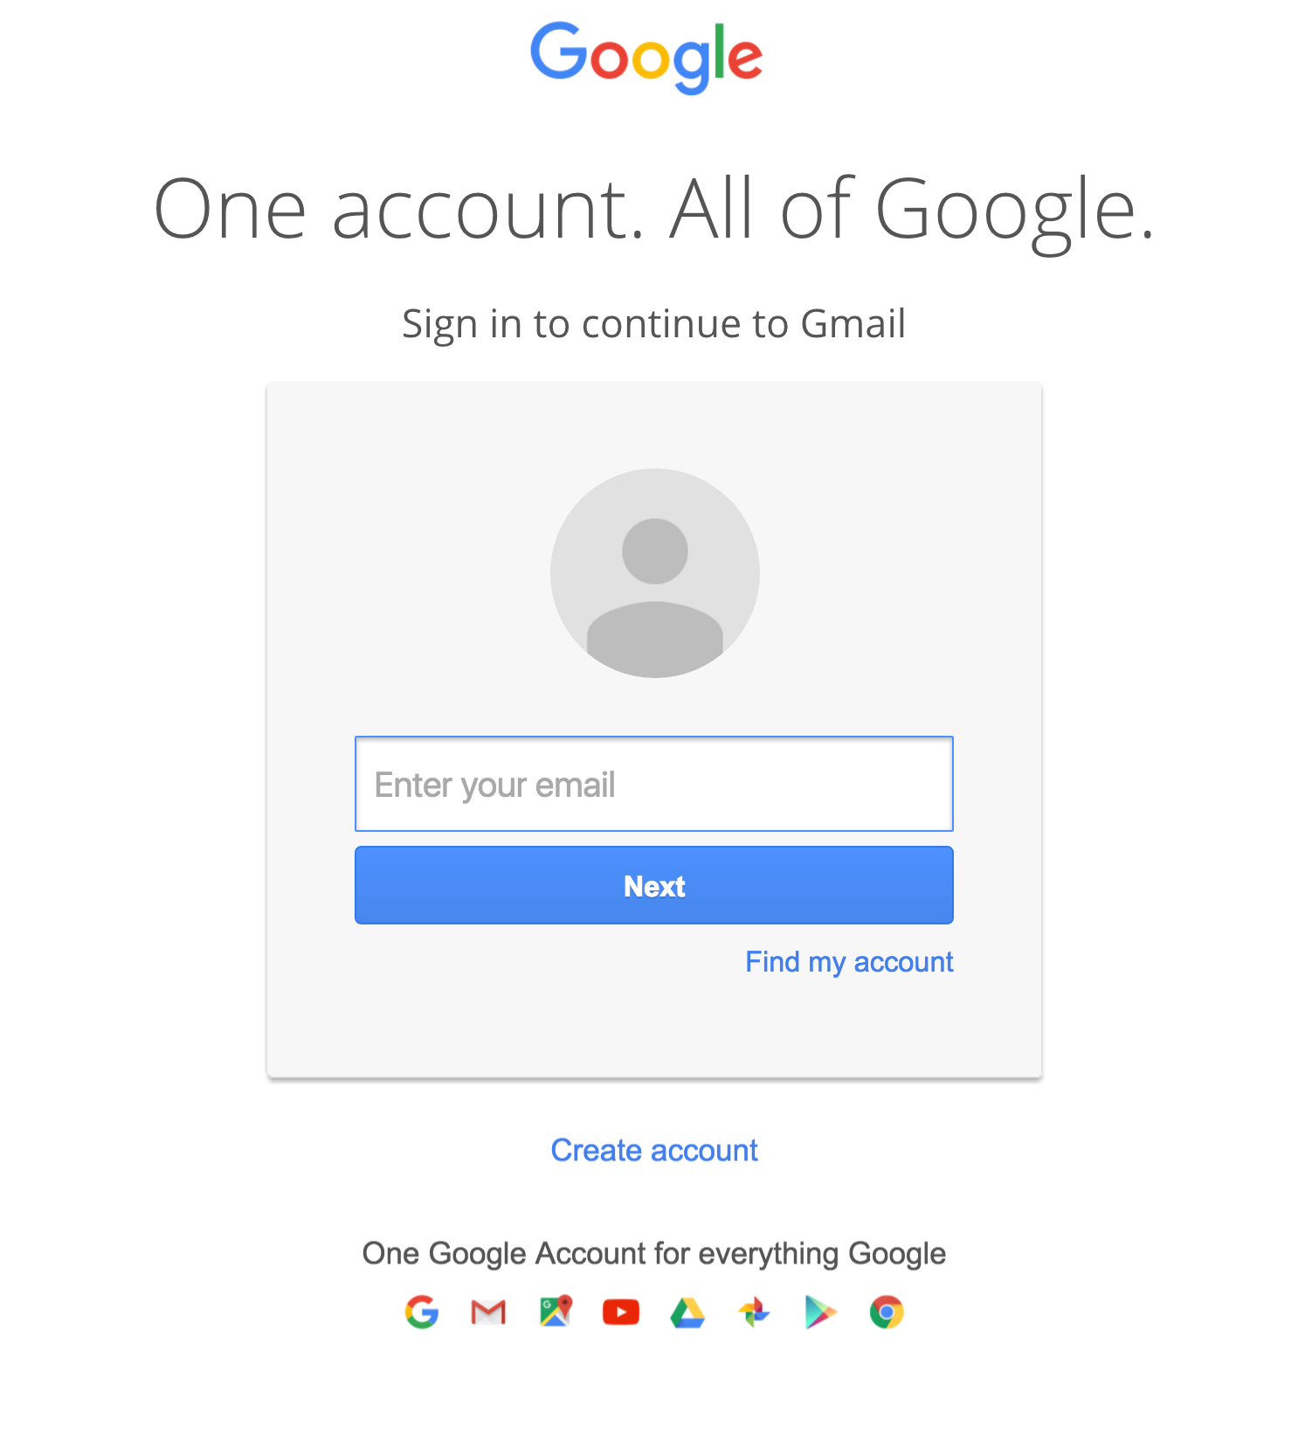
Suitable Use Cases
Storing Session Information
User Profiles, Preferences: Almost every user has a unique userID as well as preferences such as language, color, timezone, which products the user has access to , and so on.

Slide 56
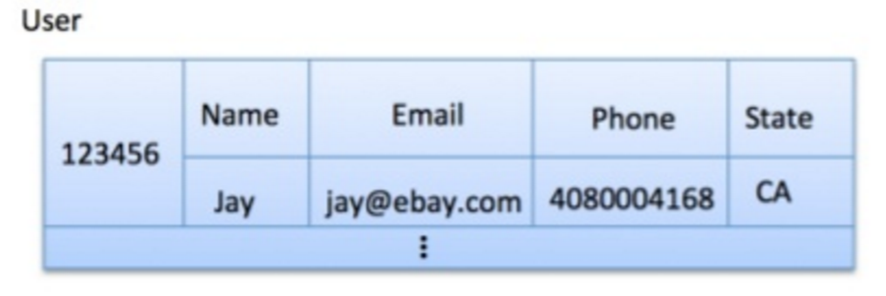
Key-Value Stores: Data Model
Stores associations between keys and values
Keys are usually primitives
For example, ints, strings, raw bytes, etc.
Values can be primitive or complex: usually opaque to store
Primitives: ints, strings, etc.
Complex: JSON, HTML fragments, etc.

Slide 57
Key-Value Stores: Operations
Very simple API:
Get – fetch value associated with key
Put – set value associated with key
Consistency model:
Eventual consistency (later)
Implementation
Just a big in-memory hash table
What if data doesn’t fit on a single machine?

Slide 58
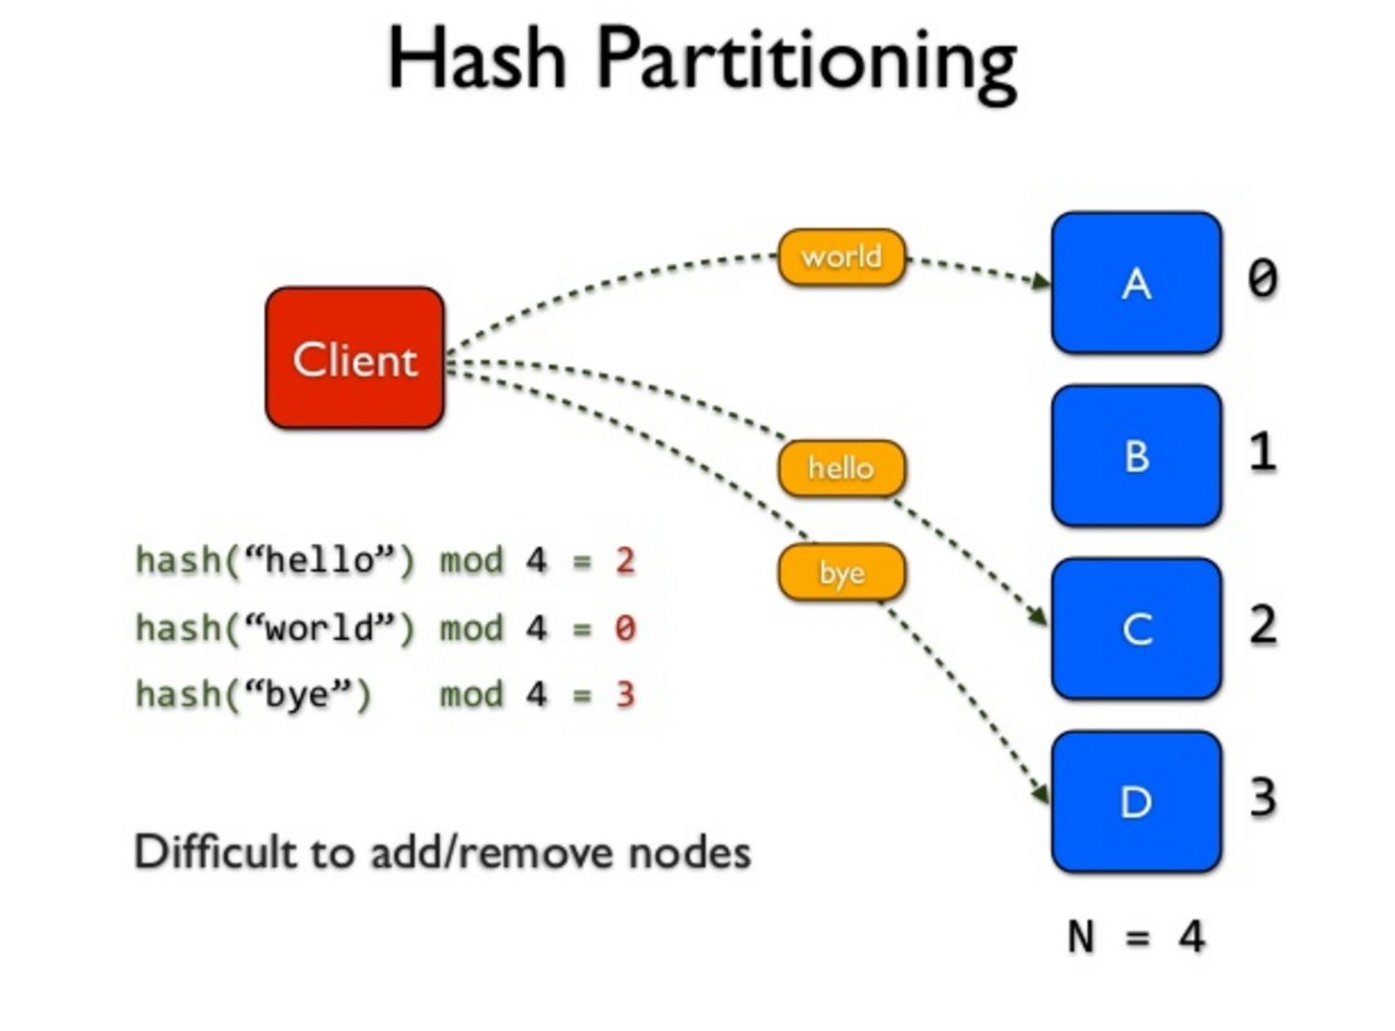
Simple Solution: Partition!
Partition the key space across multiple machines
Let’s say, hash partitioning
For n machines, store key k at machine h(k) mod n
Okay… But:
How do we know which physical machine to contact?
How do we add a new machine to the cluster?
What happens if a machine fails?
See the problems here?

Slide 59
Eventual Consistency
Eventual Consistency
When no updates occur for a long period of time, eventually all updates will propagate through the system and all the nodes will be consistent
An example
UPDATE dbo.employee SET salary=salary + 500 WHERE employee_id=1508
In order to execute this query, the database server needs to lock the row/page to ensure that no one else is viewing stale data or updating it while the query execution is in progress. The DB server need to do this for each of the query executed against the database. If there are 2 million rows updated, the database server will have to create locks for each of the 2 million rows to ensure data consistency.
80% of the applications does not require immediate consistency but requires very good performance.

Slide 60
The data/application state is not updated in all the replicas at the same time. But the primary data owner is updated and the replicas will get the update eventually.

Slide 61
Next class
CAP theory and more NoSQL & NewSQL

